Slide 1

MOOC Turns 20 Years Old: How to Recognize Plagiarism
AECT Virtual Presentation, Las Vegas, NV, USA
Ted Frick
Professor Emeritus
Indiana University
Oct. 27, 2022

Slide 2
Viewers of this presentation would also benefit from complementary presentations at AECT:
Frick, T. (2022, Oct.). Analysis of Patterns in Time (APT): A Fruitful Methodology for Investigating Learning Journeys in Education. At the annual conference of the Association of Educational Communications and Technology, Las Vegas, NV.
Wed, Oct 26, 9:50 to 10:05am PDT (12:50 to 1:05pm EDT), Conf Center, Sunset 3

Slide 3
Acknowledgements
Recent contributors to the IU Plagiarism Tutorials and Tests
  Cesur Dagli, Ph.D., Virginia Tech University
  Rodney Myers, Ph.D., Indiana University
  And others listed at: https://plagiarism.iu.edu/credits.html

Slide 4
TECHNOLOGY EMPOWERs TEACHING AND LEARNING
From teaching classes to IST students
to
teaching the world How to Recognize Plagiarism

Slide 5
Then: 2002
As a professor at Indiana University (IU), I taught approximately 100 graduate students per year in Instructional Systems Technology (IST), mostly face-to-face and occasionally online
In 2002, I led a small team of IST students in my advanced production class to design and develop the initial tutorial and test: How to Recognize Plagiarism
At new IST student orientations, we told them:
    We do not tolerate plagiarism; and we will not accept ignorance as an excuse. Do the instruction and test on your own time. Meet with your advisor if you need extra help. Hand in your signed Certificate to the department office, so we have it on file.
That's how this all got started in 2002, over 20 years ago
In following years, other instructors in colleges and high schools found our online tutorial and test to be useful and adopted it for students in their classes
I had lots of help from IST graduate students to redesign and further develop IPTAT, especially from 2012 through 2016

Slide 6
Now: through Oct. 27, 2022
I’ve been retired as a professor since 2013, no longer paid a salary
The Indiana University Plagiarism Tutorials and Tests (IPTAT) are still available to the world, free of charge, 24x7x365
So far in 2022 (nearly 43 weeks)
  161,926 students have successfully registered for IPTAT (~538 students per day)
  132,861 students have passed an IPTAT Certification Test (~441 students per day)
I manage IPTAT from home, typically spending less than an hour per day:
  It’s just me now.
  I use the same Internet Service Provider as I do for watching TV and movies at home.
  My office is my armchair and a MacBook.
  IU provides the Web servers for running IPTAT.
  Google Analytics tracks IPTAT users and stores APT temporal maps in their Cloud. IPTAT PHP scripts store student registration info and test results at IU.

Slide 7
Major Milestones: Indiana University Plagiarism Tutorials and Tests (IPTAT)
Years | Events
2002 | Legacy tutorial and test launched for students in Instructional Systems Technology
2003-12 | Legacy tutorial and test adopted worldwide, used by millions of students
2013-14 | Widespread cheating reported on 10-item Certification Test (CT). Large item pools newly developed resulting in trillions of randomized, unique 10-item CTs.
2015 | Major redesign of IPTAT using Merrill’s First Principles of Instruction
2016 | Newly designed IPTAT launched on Jan. 2. Instructional-design research via IPTAT with MOO-TALQ survey.
2019-20 | Instructional-design research via IPTAT and Google’s Universal Analytics
2021-22 | Instructional-design research via IPTAT and Google Analytics 4

Slide 8
IPTAT Annual Pageviews

Slide 9
Big Data: From Jan. 1, 2016 through Oct. 27, 2022 (356 weeks), more than
1,276,000 students have successfully registered for IPTAT
  3,584 per week
  512 per day
  21 per hour
1,027,000 students have passed a difficult IPTAT Certification Test
  2,884 per week
  412 per day
  17 per hour

Slide 10
We started out with online teaching and learning, and now it is providing big data for instructional-design research.

Slide 11
Enough for now? Learn more about How to Recognize Plagiarism at your own pace
On the Web you can go to:
  https://plagiarism.iu.edu (see for your self)
  https://plagiarism.iu.edu/faq.html (answers to frequently asked questions)
  https://mapsat.iu.edu (presentations, published journal articles, book chapters, and new book)

Slide 12
What is iptat?
Indiana University Plagiarism Tutorials and Tests

Slide 13
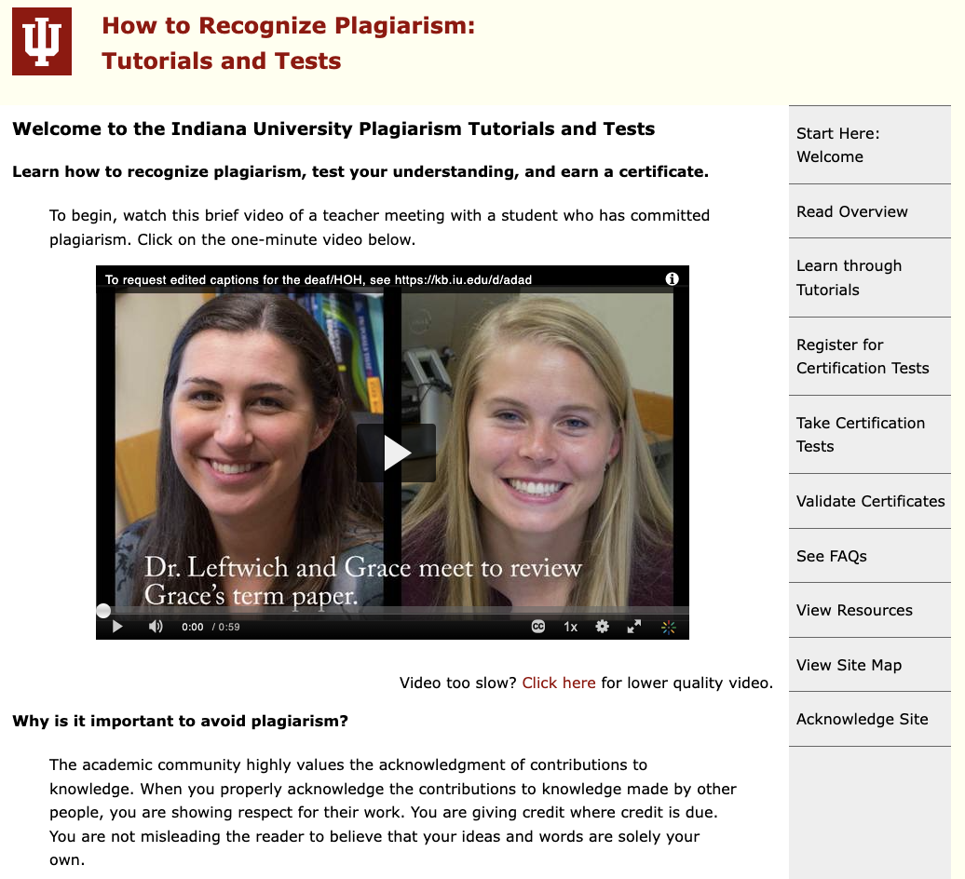
2016:
Redesign of Indiana University Plagiarism Tutorials and Tests (IPTAT) using First Principles of Instruction

Slide 14
First Principles of Instruction (FPI) used to redesign IPTAT: [Source: Merrill, 2020]
Authentic problems or tasks for students to do, arranged from simple to complex (e.g., https://plagiarism.iu.edu/tutorials/index.html);
Activation of student learning by helping students connect new learning with what they already know or believe (e.g., https://plagiarism.iu.edu/tutorials/task1/activation.html);
Demonstration of what is to be learned, by showing a variety of examples (e.g., https://plagiarism.iu.edu/tutorials/task1/demonstration.html);
Application of what is being learned, so students can try themselves and feedback is provided (e.g., https://plagiarism.iu.edu/practiceTest.php?task=1&item=1); and
Integration of what has been learned into students’ own lives (e.g., https://plagiarism.iu.edu/tutorials/task1/integration.html).

Slide 15
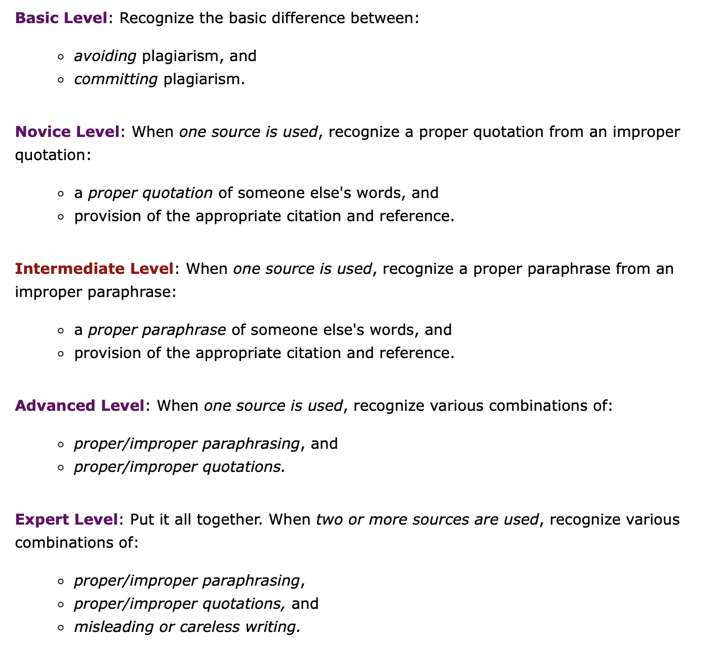
IPTAT Design Example:
Authentic Problems

Slide 16
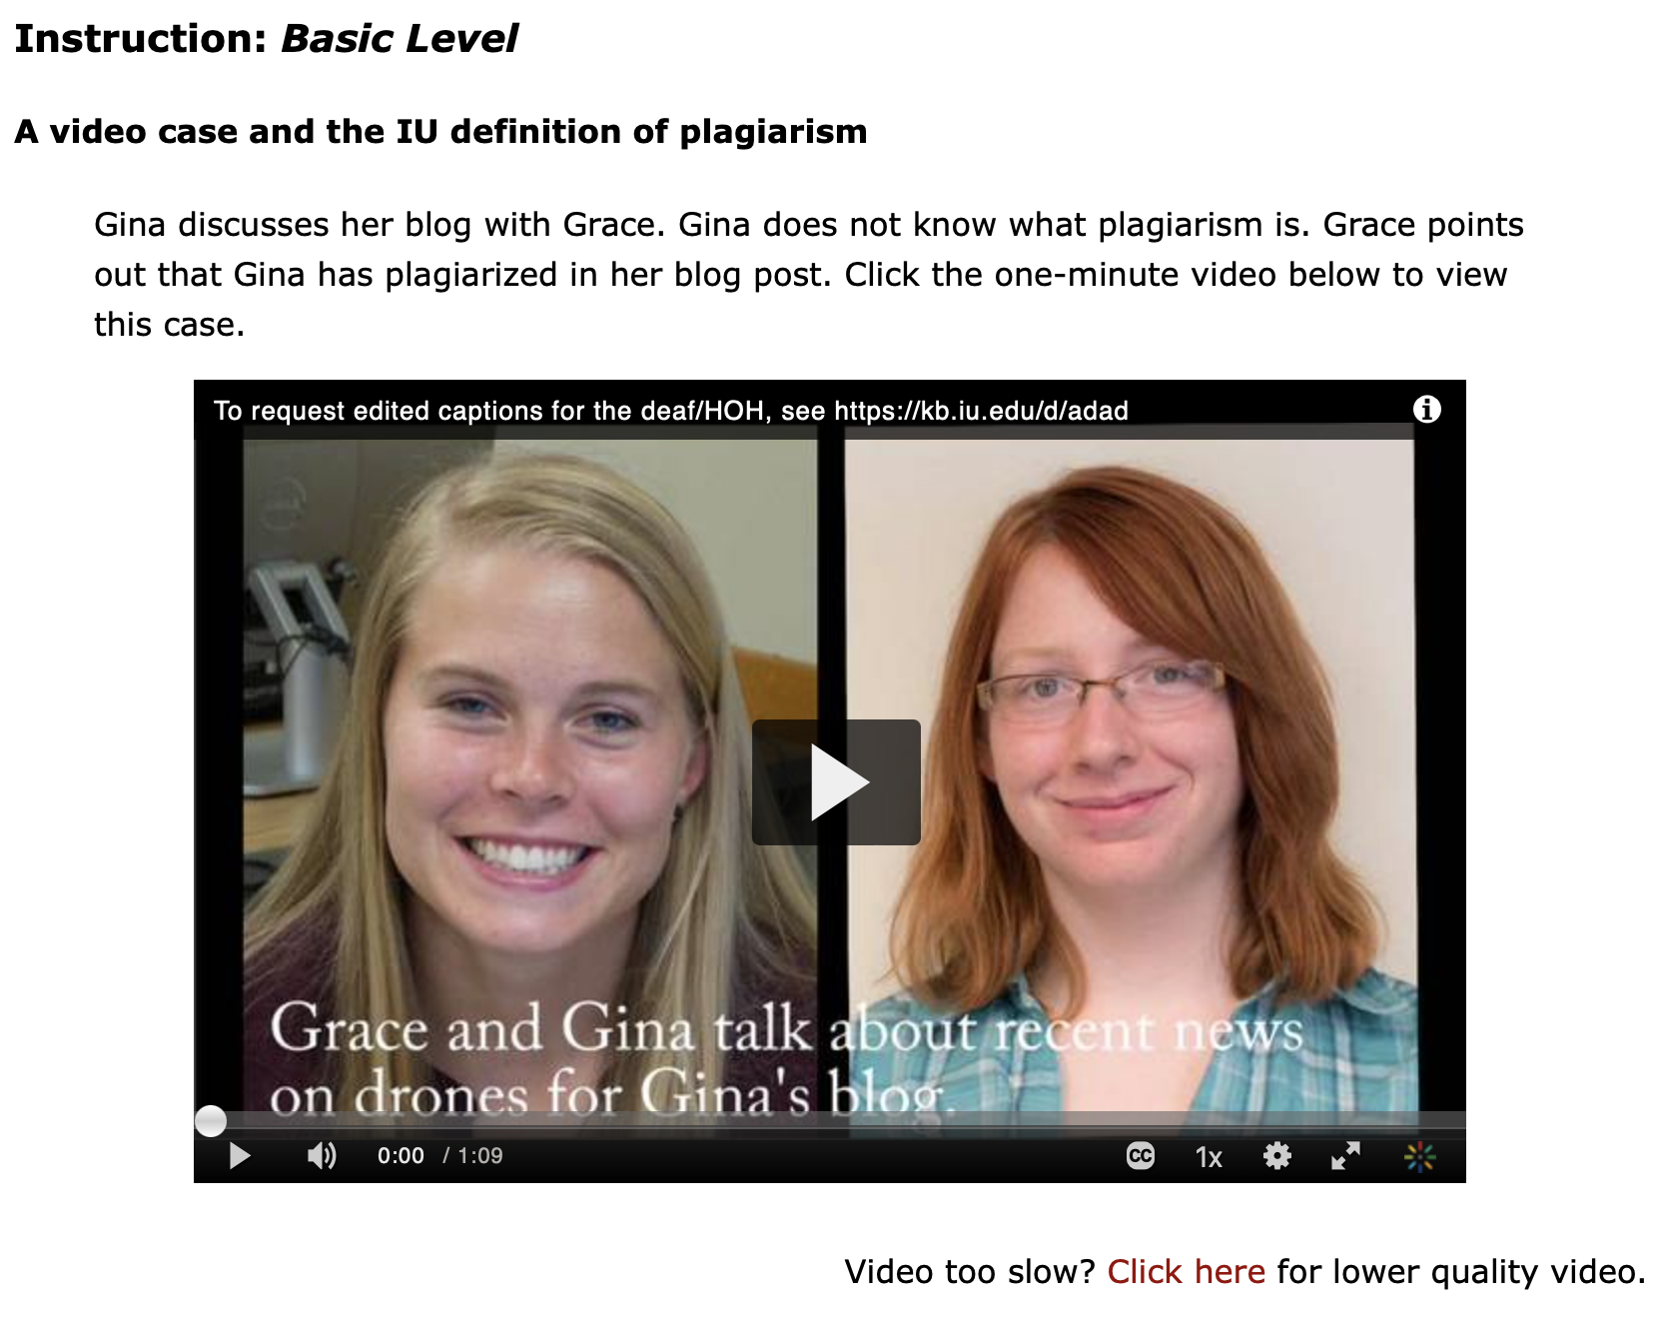
IPTAT Design Example:
Activation

Slide 17
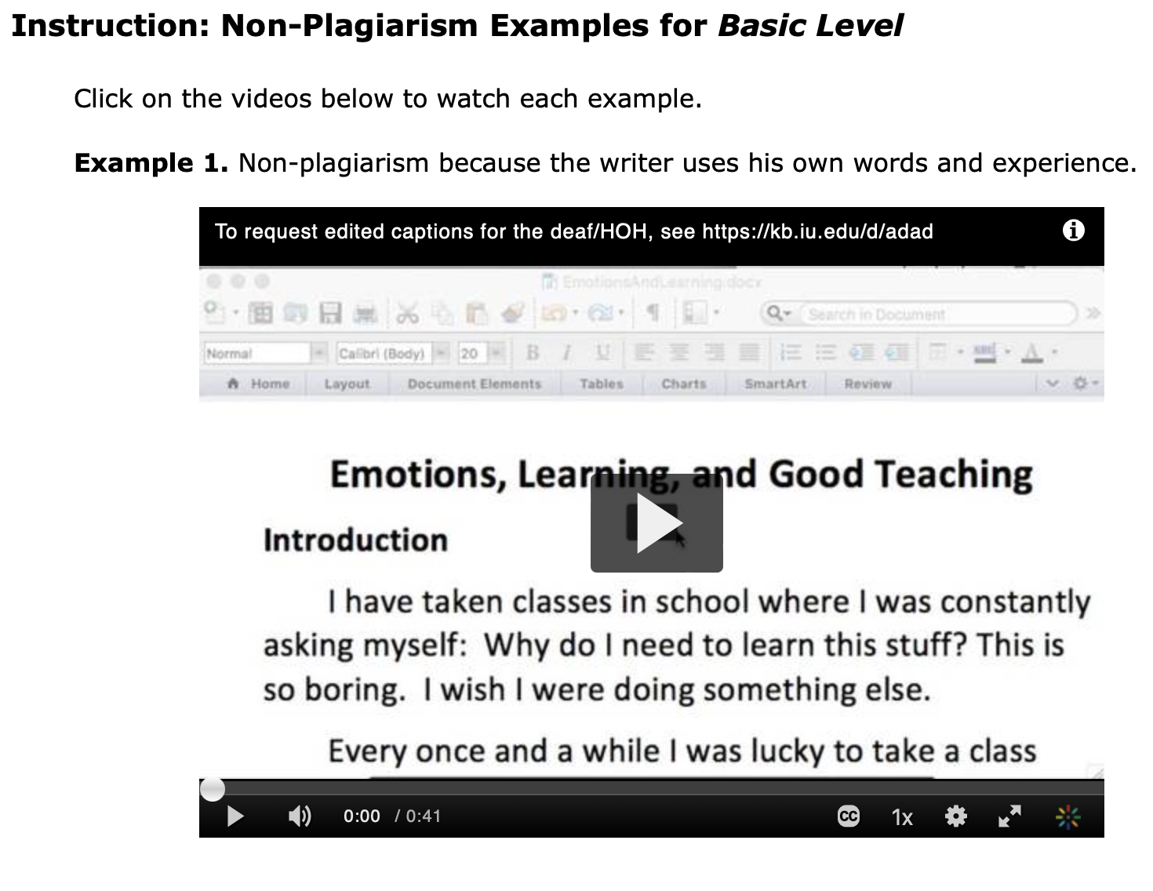
IPTAT Design Example:
Demonstration

Slide 18
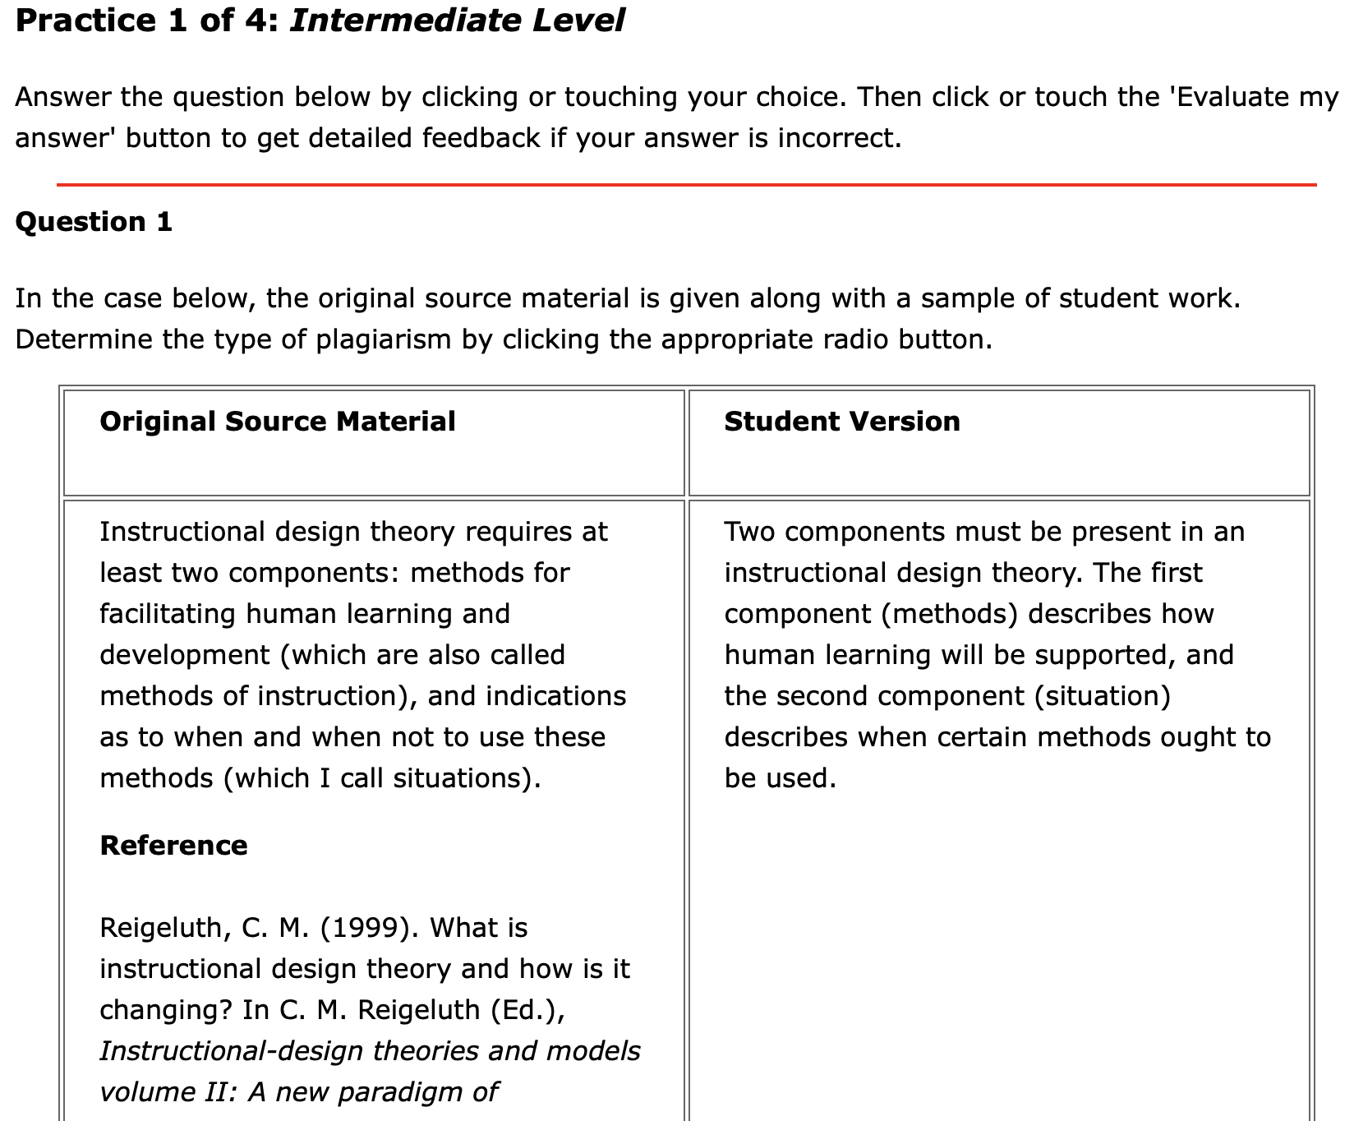
IPTAT Design Example:
Application
Is it:
- Word-for-word plagiarism
- Paraphrasing plagiarism
- Non-plagiarism?

Slide 19
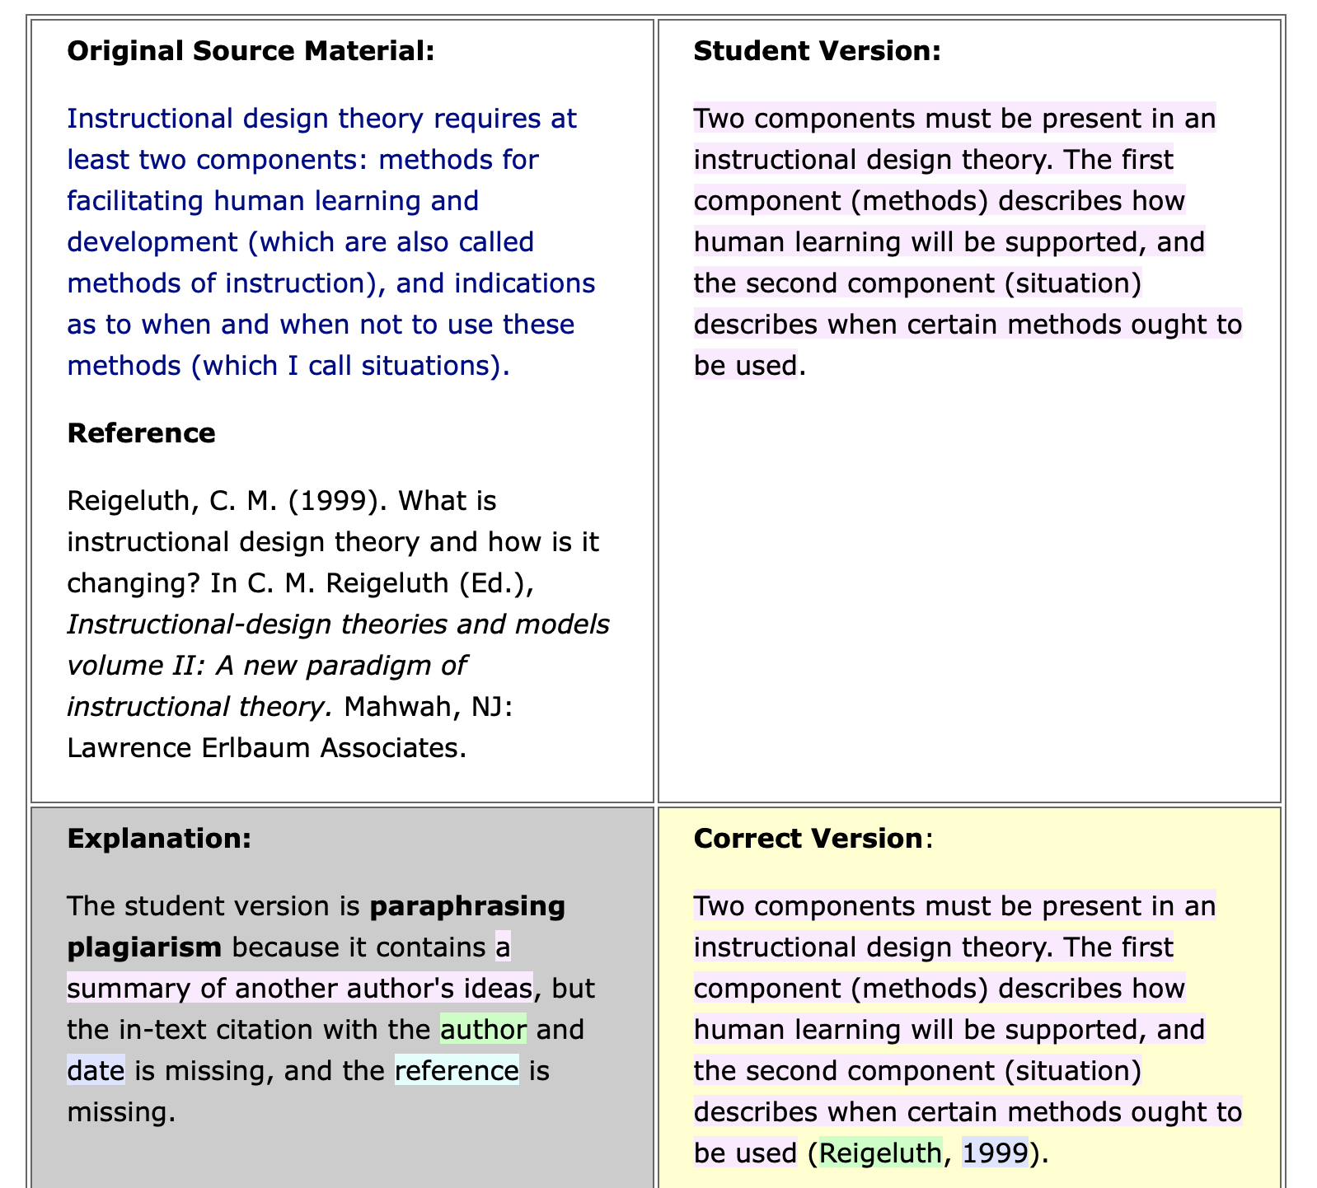
IPTAT Design Example:
Application
Feedback

Slide 20
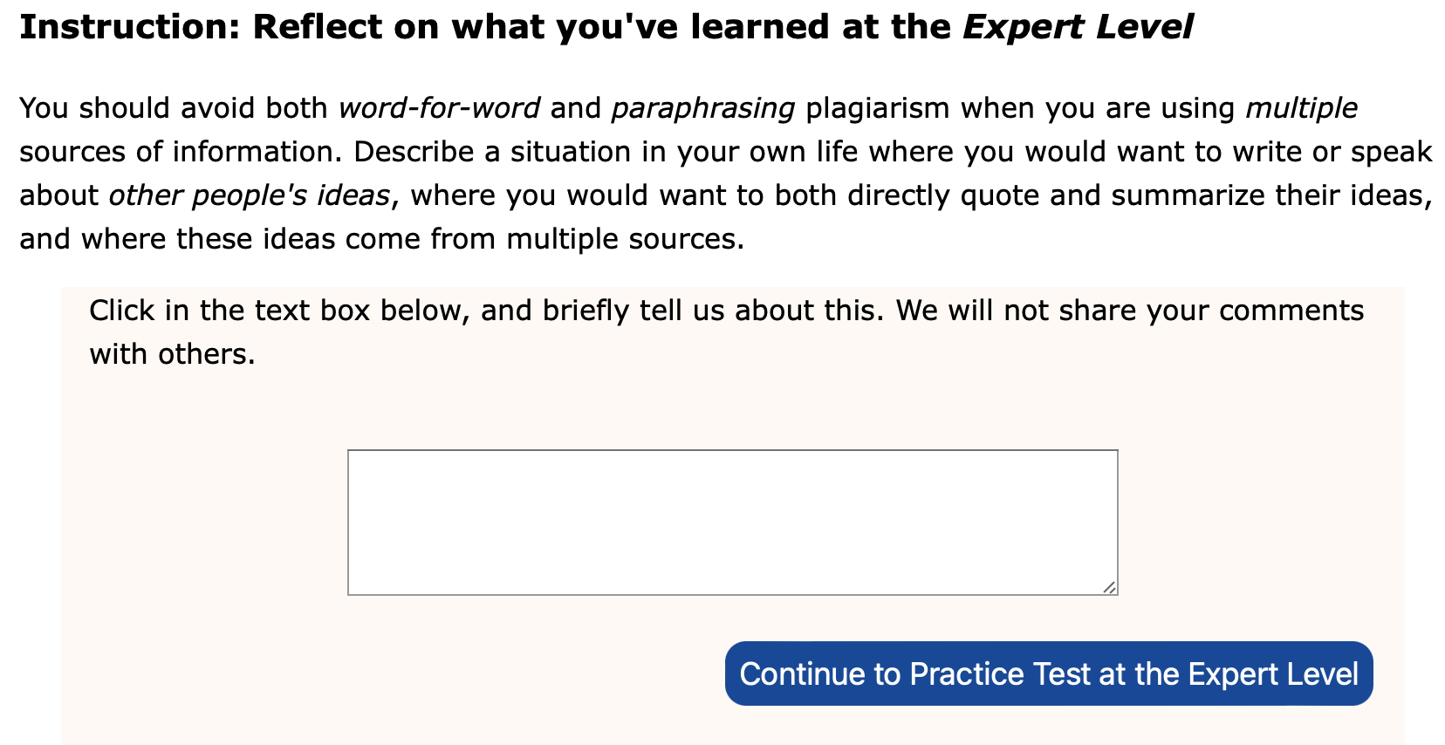
IPTAT Design Example:
Integration

Slide 21
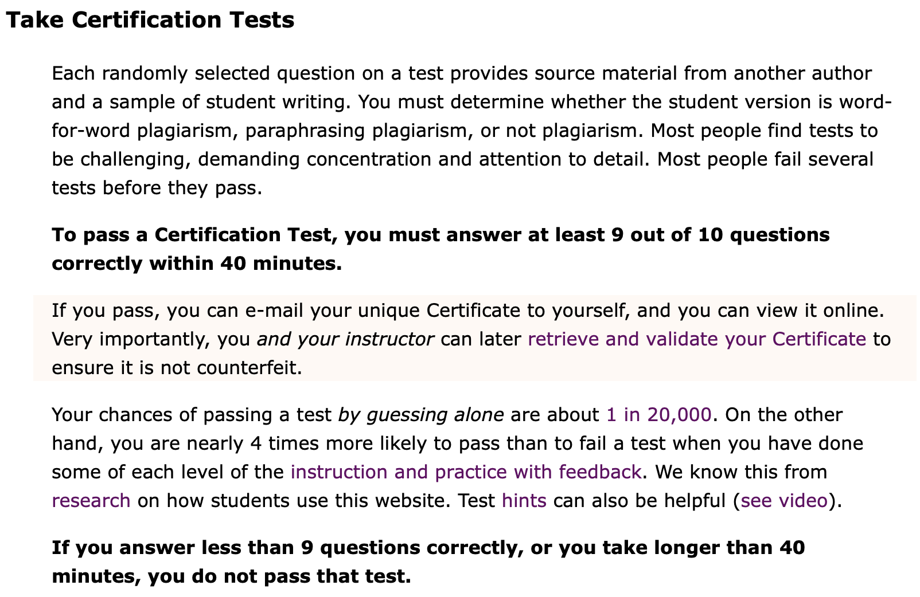
Certification Test:
Instructions

Slide 22
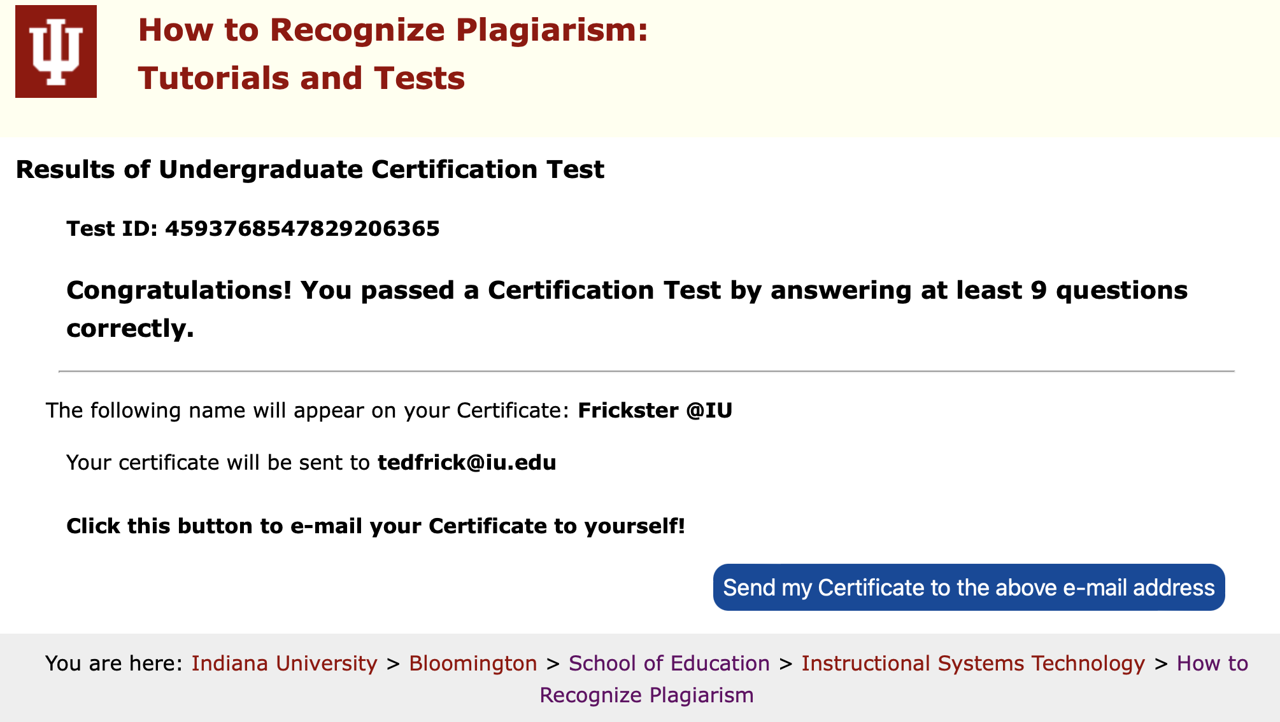
Certification Test:
Feedback when passing

Slide 23
Summary of Design by First Principles of Instruction (FPI)
Within each level of complexity (Basic, Novice, Intermediate, Advanced, Expert), there are further FPI-designed learning activities:
  Activation
  Demonstration
  Application
  Integration
  Mastery Test
Students can navigate freely through IPTAT, picking and choosing what parts to do via sidebar navigation, an overall sitemap, and next page links
There are trillions of criterion-referenced Certification Tests, each with 10 items randomly selected (pass/fail)

Slide 24
A new paradigm for instructional-design research
MOOLA for IDR

Slide 25
Massive Open Online Learning Analytics for Instructional-Design Research
MOOLA for ID Research: A New Paradigm for Educational Inquiry
IPTAT is Massive, used by literally millions of students and instructors worldwide
IPTAT is Open, available to anyone at no charge
IPTAT is Online, accessible via the Web using computers, smartphones, and tablets
We use Learning Analytics (LA)—specifically APT, Analysis of Patterns in Time—for Instructional-Design (ID) Research
MOOLA is also slang for money (‘moolah’ is a Fijian word, meaning money)
But the pay-off is not money, rather Big Data for research on effective teaching and learning methods

Slide 26
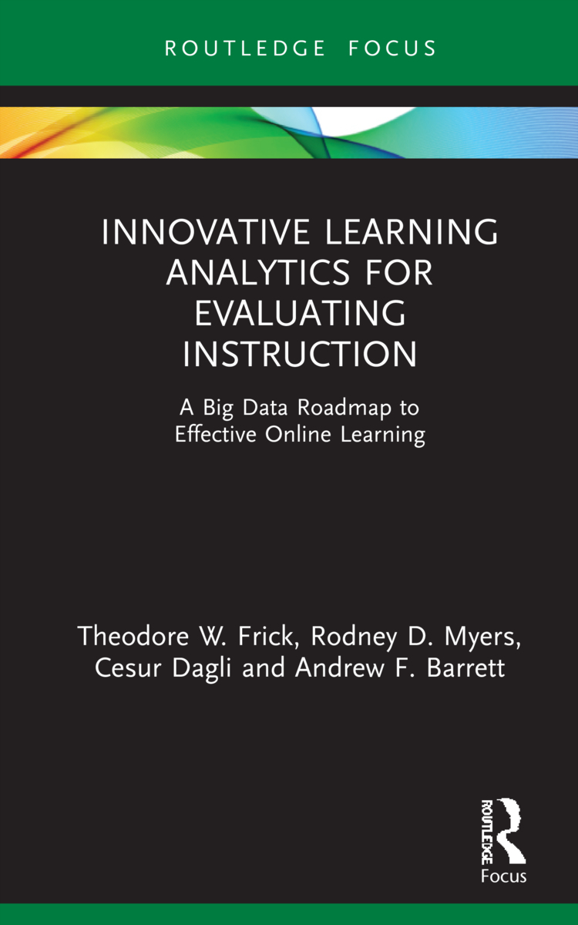
New book: 2022
Google Analytics tracked student use of IPTAT website for 2 years, 2019-20
  Approximately 936,000 learning journeys, students from 222 countries and territories worldwide
  About 1.9M temporal maps, 36M pageviews
We discovered in 2020 that Google’s Universal Analytics (UA) could be leveraged to do Analysis of Patterns in Time (APT) when coupled with Excel spreadsheets
Main APT finding: Successful students viewed 3 to 4 times as many unique Web pages designed with First Principles of Instruction as did unsuccessful students

Slide 27
2022: Featured research paper in ETR&D (follow-up using Google Analytics 4 to do some of APT)
GA4 tracked 172,417 learning journeys of students who were interacting with IPTAT from Jan. 1 through Mar. 25, 2021
In 75,087 learning journeys, students took 2 or more Certification Tests (CTs)
  51,646 journeys resulted in passing a CT (Achievers)
  23,307 did not pass a CT in 2 or more attempts (Nonmasters)
Of the 51,646 Achievers,
  42,046 had tried one or more IPTAT webpages designed with First Principles of Instruction (Traditionalists)
  9,600 did NOT try any FPI webpages (Minimalists)

Slide 28
Latest APT Results of 131,083 Learning Journeys Using GA4 (Aug. 21 – Oct. 18, 2022)
Learning Strategy | Non-Achiever | Achiever | Total | Likelihood of Passing | Likelihood of Failing | Odds P:F
Guessing (theoretical) | 19,682 | 1 | 19,683 | 0.000 | 1.000 | 0.00
Minimalist (No FPI) | 7,918 | 6,836 | 14,754 | 0.463 | 0.537 | 0.86
Traditionalist: Any FPI | 16,532 | 34,551 | 51,083 | 0.676 | 0.324 | 2.09
Plagiarism Patterns Only | 7,898 | 14,765 | 22,663 | 0.652 | 0.348 | 1.87
Practice Questions with Feedback | 5,989 | 15,350 | 21,339 | 0.719 | 0.281 | 2.56
Maximalist (some of each FPI) | 1,607 | 6,424 | 8,031 | 0.800 | 0.200 | 4.00
Achievers & Test Evals | 40,838
Non-Achievers & Test Evals | 23,834
Total Test Evals | 64,672
Active Users & No Test Evals | 66,411
Grand Total Learning Journeys | 131,083
Maximalists were 4 times more likely to pass a Certification Test. Maximalists had tried at least some of each part of IPTAT designed with First Principles of Instruction.

Slide 29
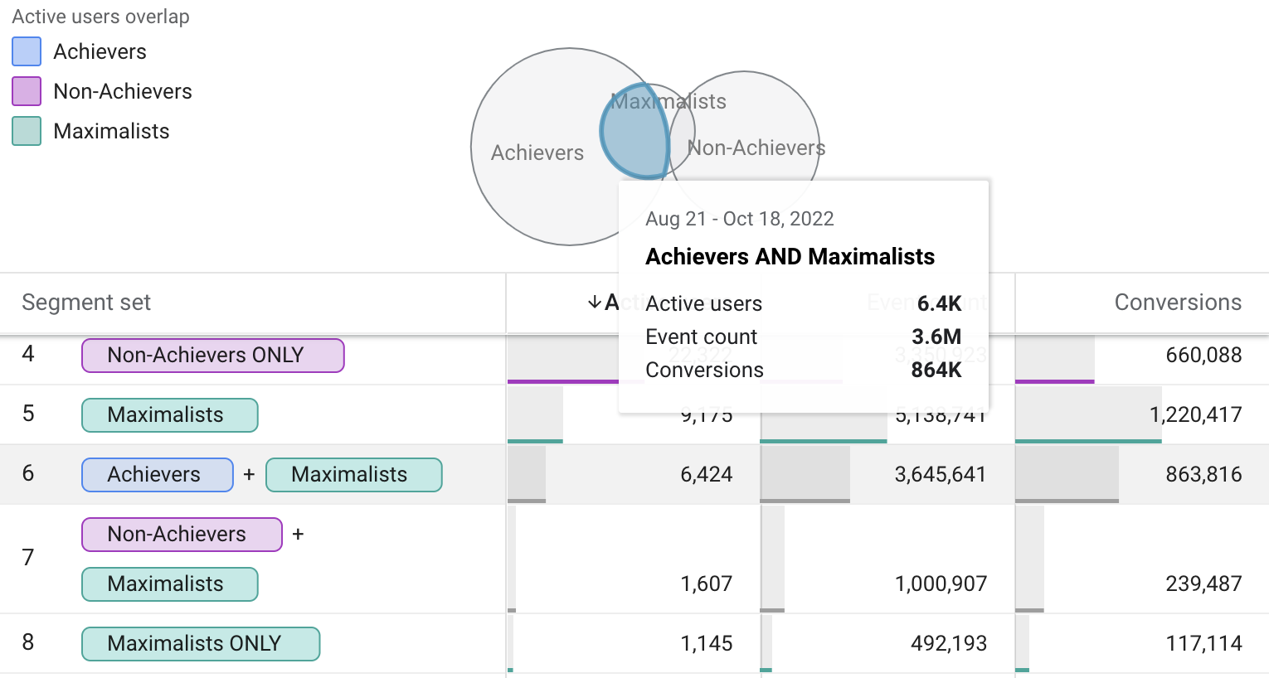
Doing Analysis of Patterns in Time with
Google Analytics 4 (GA4) Segment Overlap

Slide 30
Is IPTAT a MOOC?
Does it matter?

Slide 31
Is IPTAT a MOOC: Massive Open Online Course?
IPTAT definitely is massive, open, and online
IPTAT is not a college or high school course as traditionally conceived; rather, IPTAT has been adopted as an instructional module by thousands of instructors worldwide, who use IPTAT as part of their courses
Student-to-student and student-to-instructor interaction happens in those instructor’s classes who have adopted IPTAT
Student-to-student interaction also occurs in course LMSs, as well as social networks such as Reddit, Twitter and Facebook
Students and instructors also contact IPTAT developers through an important feedback loop via Google Groups--user feedback has led to many improvements
IPTAT developers also have created FAQs at https://plagiarism.iu.edu/faq.html to help save everyone time

Slide 32
IPTAT has been available for 20 years
IPTAT is
  Sustainable: now in its 3rd decade of existence 24x7x365
  Effective: Millions of students have learned to recognize plagiarism and pass Certification Tests
  Interoperable: works on almost any device (desktops, laptops, tablets, smartphones)
  Economical: requires minimal maintenance most of the time
  Flexible: can be used as part of a course much like textbooks or other learning objects; or it can be used stand-alone
Does it really matter whether IPTAT conforms to a narrow conception of MOOCs?

Slide 33
References
Frick, T. W. & Dagli, C. (2016). MOOCs for research: The case of the Indiana University plagiarism tutorials and tests. Technology, Knowledge and Learning, 21(2), 255-276. https://rdcu.be/mEvf
Frick, T. W., Myers, R. D., & Dagli, C. (2022). Analysis of Patterns in Time for Evaluating First Principles of Instruction (SharedIt): https://doi.org/10.1007/s11423-021-10077-6
Frick, T. W., Myers, R. D., Dagli, C., & Barrett, A. F. (2022). Innovative learning analytics for evaluating instruction: A big data roadmap to effective online learning. Routledge. https://doi.org/10.4324/9781003176343
Google Analytics (2005 - present). Wikipedia entry: https://en.wikipedia.org/wiki/Google_Analytics
Indiana University Plagiarism Tutorials and Tests (2002-present). How to recognize plagiarism. Retrieved from https://plagiarism.iu.edu
Merrill, M. D. (2020). M. David Merrill’s first principles of instruction. Association for Educational Communications and Technology.

Slide 34
Links for the Indiana University Plagiarism Tutorial and Tests (IPTAT)
To see IPTAT for yourself:
  https://plagiarism.iu.edu
Slides of this presentation (PDF)
  https://plagiarism.iu.edu/apt/IPTATturns20yearsOld.pdf
Link to recording of this presentation
  https://mapsat.iu.edu

