Slide 1

Analysis of Patterns in Time (APT): A Fruitful Methodology for Investigating Learning Journeys in Education
AECT Virtual Presentation, Las Vegas, NV, USA
Ted Frick
Professor Emeritus
Indiana University
Oct. 26, 2022

Slide 2
What they didn’t teach you in graduate school courses on educational research methods: Analysis of Patterns in Time
Alternate Title
Ted Frick
Professor Emeritus
Indiana University
Oct. 26, 2022

Slide 3
Biggest Adopters of Analysis of Patterns in Time—thus far
Google Analytics
Major League Baseball (and other professional sports)
Emerging methods in:
  Data Science
  Machine Learning
  Artificial Intelligence

Slide 4
The latest big Findings
Using Analysis of Patterns in Time (APT)

Slide 5
Based on temporal maps of learning journeys through the online Indiana University Plagiarism Tutorials and Tests (IPTAT):
Students who try any part of IPTAT designed with First Principles of Instruction (FPI; Merrill, 2020) are 2 times more likely to achieve the learning goal than not.
Students who try all parts of IPTAT designed with FPI are 4 times more likely to achieve the learning goal than not.
Students who try no parts designed with FPI are 1.2 times more likely to fail to achieve the learning goal (using other parts not designed with FPI).
These conclusions are based on Analysis of Patterns in Time of more than 131,000 learning journeys by adult students from 169 countries worldwide between Aug. 21 and Oct. 18, 2022.

Slide 6
Enough for now? Learn more about Analysis of Patterns in Time at your own pace
On the Web you can go to mapsat.iu.edu for access to
  Presentation slides for professional conferences
  Screencasts of those slide presentations (with voice over)
  Published journal articles, book chapters, and new book
  Demonstration videos of how to do APT with Google Analytics
Map & Analyze Patterns & Structures Across Time: MAPSAT
https://mapsat.iu.edu

Slide 7
A Quick flyover:
50 years of my research in 15 minutes
Today’s presentation is analogous to a jet flyover from
New York to San Francisco.
More details are in the underlined Web links.

Slide 8
Searching for an alternative research methodology
In 1972 I began my learning analytics quest (50 years ago):
  How can we make learning better?
    What research methods are needed to verify this empirically?
    How can we verify dynamically what teachers and students do that leads to student learning achievement?
Empirical studies using quantitative linear models (multiple regression analysis, ANOVA, ANCOVA) lacked specificity because of the state-trait approach to measurement and algebraic linear assumptions
Empirical studies using qualitative methods (ethnography, episodic narrative) lacked generalizability because of small sample sizes and selection bias

Slide 9
1976: I invented Nonmetric Temporal Path Analysis (NTPA) as an alternative
The fundamental idea of a temporal map emerged
We needed something analogous to orchestral scores and EKG’s
  Parallel timelines
  Ways to characterize change

Slide 10
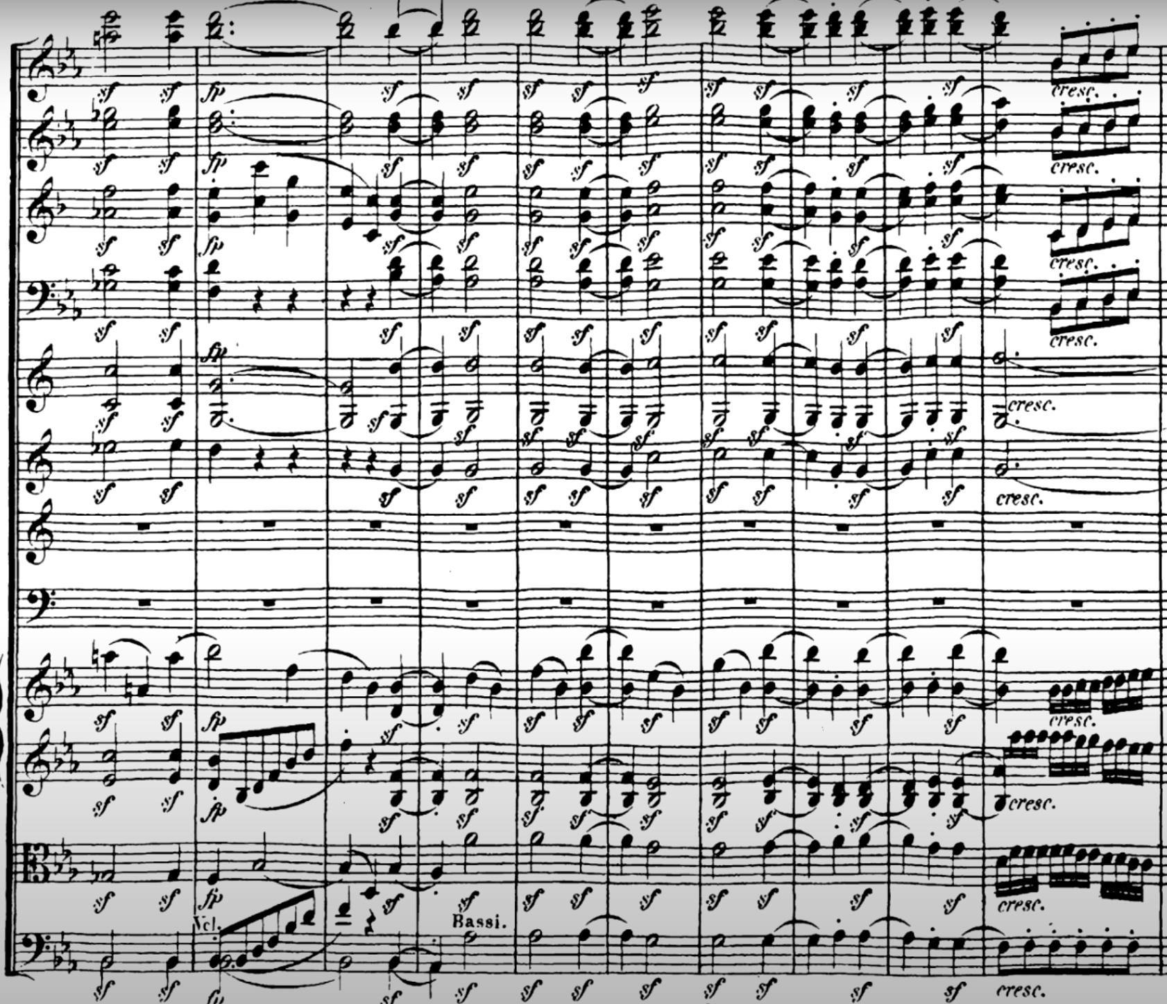
Temporal Map Example:
Orchestral score:
Excerpt from Beethoven’s 3rd Symphony
[source: YouTube]

Slide 11
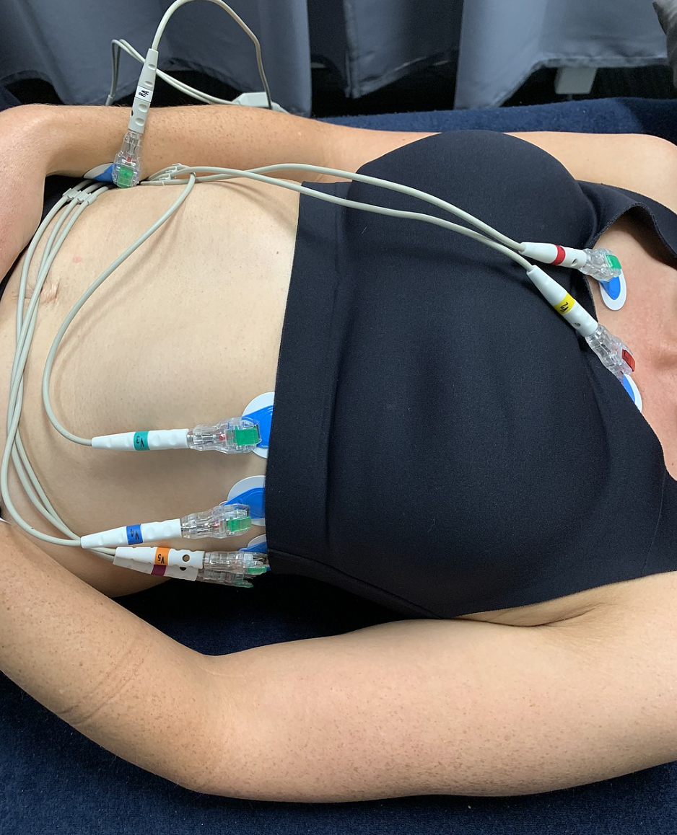
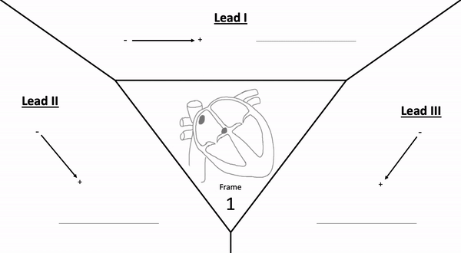
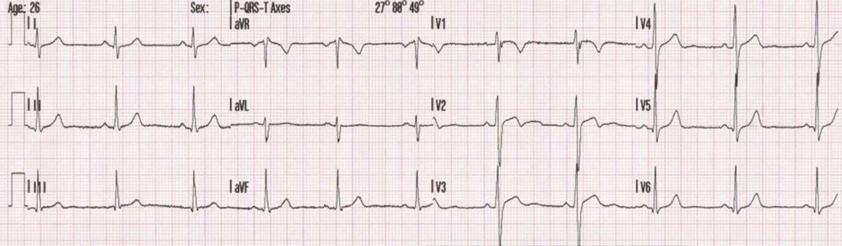
Temporal Map Example: ECG: Electrocardiogram (heart) [source Wikipedia]

Slide 12
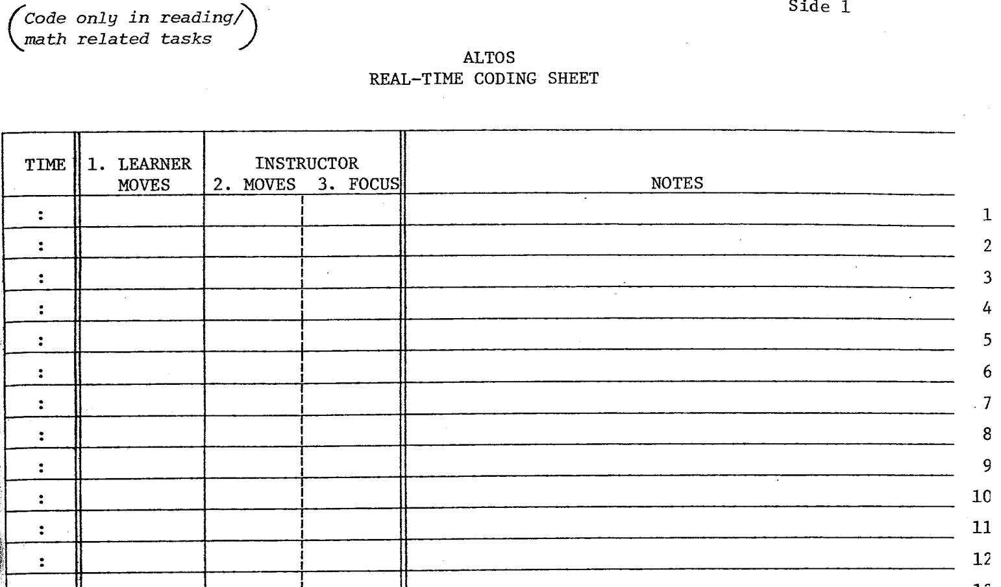
Temporal Map Example: ALTOS: Academic Learning Time Observation System [source: Frick & Rieth, 1981]
Trained classroom observers followed target students for a total of 8-10 hours each over several days, recording their codes on paper forms similar to this one. This resulted in temporal maps of what each target student and their teachers did during reading and math activities.

Slide 13
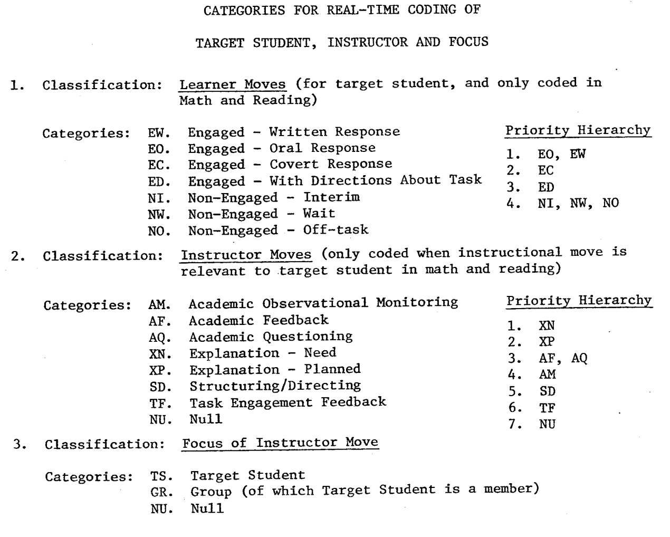
ALTOS
Event classifications and categories
[Source: Frick & Reith, 1981]
EN
NE
DI
ND
EN = Student Engagement; NE = Student Non-Engagement;
DI = Direct Instruction; ND = Non-Direct Instruction

Slide 14
A Simple Temporal Map with 2 Classifications: Part of a Learning Journey
Joint Temporal Event (JTE) | Time (HH:MM) | Target Student Move | Instructor Move
1 | 10:15 | NE | ND
2 | 10:16 | NE | ND
3 | 10:17 | EN | ND
4 | 10:18 | EN | DI
5 | 10:19 | EN | DI
6 | 10:20 | NE | DI
7 | 10:21 | EN | DI
8 | 10:22 | NE | ND
9 | 10:23 | NE | ND
10 | 10:24 | NE | ND
11 | 10:25 | EN | DI
12 | 10:26 | EN | DI
Key
Target Student Move
Engaged (EN)
Non-Engaged (NE)
Instructor Move
Direct Instruction (DI)
Non-Direct Instruction (ND)
Trained classroom observers tracked a target student and coded their moves and their instructor’s moves at one-minute intervals

Slide 15
Temporal Map with NTPA Queries for part of a Learning Journey*
Joint Temporal Event (JTE) | Time (HH:MM) | Target Student Move | Instructor Move | Query 1 p(DI) | Query 2 p(EN) | Query 7 p(EN | DI) | Query 8 p(NE | DI)
1 | 10:15 | NE | ND
2 | 10:16 | NE | ND
3 | 10:17 | EN | ND |  | 1
4 | 10:18 | EN | DI | 1 | 1 | 1
5 | 10:19 | EN | DI | 1 | 1 | 1
6 | 10:20 | NE | DI | 1 |  |  | 1
7 | 10:21 | EN | DI | 1 | 1 | 1
8 | 10:22 | NE | ND
9 | 10:23 | NE | ND
10 | 10:24 | NE | ND
11 | 10:25 | EN | DI | 1 | 1 | 1
12 | 10:26 | EN | DI | 1 | 1 | 1
*a 1 signifies that the query is true for that JTE

Slide 16
Temporal Map with further NTPA Queries for Learning Journey 1
Joint Temporal Event (JTE) | Time (HH:MM) | Target Student Move | Instructor Move | Query 1 p(DI) | Query 2 P(EN) | Query 3 p(DI∩EN) | Query 4 p(DI∩NE) | Query 5 p(ND∩EN) | Query 6 p(ND∩NE) | Query 7 p(EN ⎜DI) | Query 8 p(EN ⎜ND)
1 | 10:15 | NE | ND |  |  |  |  |  | 1
2 | 10:16 | NE | ND |  |  |  |  |  | 1
3 | 10:17 | EN | ND |  | 1 |  |  | 1 |  |  | 1
4 | 10:18 | EN | DI | 1 | 1 | 1 |  |  |  | 1
5 | 10:19 | EN | DI | 1 | 1 | 1 |  |  |  | 1
6 | 10:20 | NE | DI | 1 |  |  | 1
7 | 10:21 | EN | DI | 1 | 1 | 1 |  |  |  | 1
8 | 10:22 | NE | ND |  |  |  |  |  | 1
9 | 10:23 | NE | ND |  |  |  |  |  | 1
10 | 10:24 | NE | ND |  |  |  |  |  | 1
11 | 10:25 | EN | DI | 1 | 1 | 1 |  |  |  | 1
12 | 10:26 | EN | DI | 1 | 1 | 1 |  |  |  | 1
(588 JTE’s not shown here)
600
 | Freq. |  |  | 300 | 480 | 276 | 24 | 204 | 96 | 276 | 204
 | Prob. |  |  | 0.50 | 0.80 | 0.46 | 0.04 | 0.34 | 0.16 | 0.92 | 0.67

Slide 17
1983: Frick dissertation findings: NTPA
Learning Journey | p(DI) | p(EN) | p(DI ∩ EN) | p(DI ∩ NE) | p(ND ∩ EN) | p(ND ∩ NE) | p(EN ⎜DI) | p(EN ⎜ND)
1 | 0.50 | 0.80 | 0.46 | 0.04 | 0.34 | 0.16 | 0.92 | 0.67
2 | 0.39 | 0.49 | 0.37 | 0.02 | 0.12 | 0.49 | 0.95 | 0.20
3 | 0.27 | 0.56 | 0.26 | 0.01 | 0.30 | 0.43 | 0.97 | 0.41
4 | 0.34 | 0.69 | 0.34 | 0.00 | 0.35 | 0.31 | 1.00 | 0.53
5 | 0.48 | 0.73 | 0.47 | 0.01 | 0.25 | 0.26 | 0.98 | 0.49
6 | 0.40 | 0.75 | 0.39 | 0.01 | 0.35 | 0.25 | 0.98 | 0.59
7 - 25 | … | … | … | … | … | … | … | …
Mean (SD) | 0.432 (0.144) | 0.741 (0.101) | 0.416 (0.139) | 0.015 (0.010) | 0.324 (0.114) | 0.243 (0.104) | 0.967 (0.029) | 0.573 (0.142)
The likelihood of Student Engagement was 0.967 when Direct Instruction was occurring.
Key: DI = Direct Instruction; EN = Student Engagement;
NE = Student Non-Engagement; ND = Non-Direct Instruction

Slide 18
1983: Linear models scatterplot [Frick]
Pearson correlation
  r = 0.57
  r² = 0.33
NTPA probabilities
  p(EN|DI) = 0.97
  p(EN|ND) = 0.57
  p(NE|DI) = 0.03
  p(NE|ND) = 0.43
Regression line:
EN = 0.4DI + 0.57
Key: DI = Direct Instruction; EN = Student Engagement;
NE = Student Non-Engagement; ND = Non-Direct Instruction

Slide 19
1983: Conclusion from same classroom observations
NTPA approach
  When direct instruction is occurring, mildly handicapped students in elementary schools are engaged about 97 % of the time.
  When direct instruction is not occurring, those students are engaged about 57 percent of the time. Students are about 13 times more likely NOT to be engaged in academic tasks when NO direct instruction is occurring.
Linear models approach
  The amount of time spent in direct instruction is correlated moderately and positively with the amount of student engagement time (r = 0.57)
  33 % of the variance in student engagement time is predicted by the amount of direct instruction time; 67 % of the variance in student engagement time is NOT predicted by the amount of direct instruction (r² = 0.57² = 0.33; 1 – 0.33 = 0.67)

Slide 20
1983: Why the difference in conclusions from same classroom observations?
NTPA approach measures the relations
  whereas
Linear models approach relates the measures
This is not a play on words, but a profound difference in approach to characterizing relations.

Slide 21
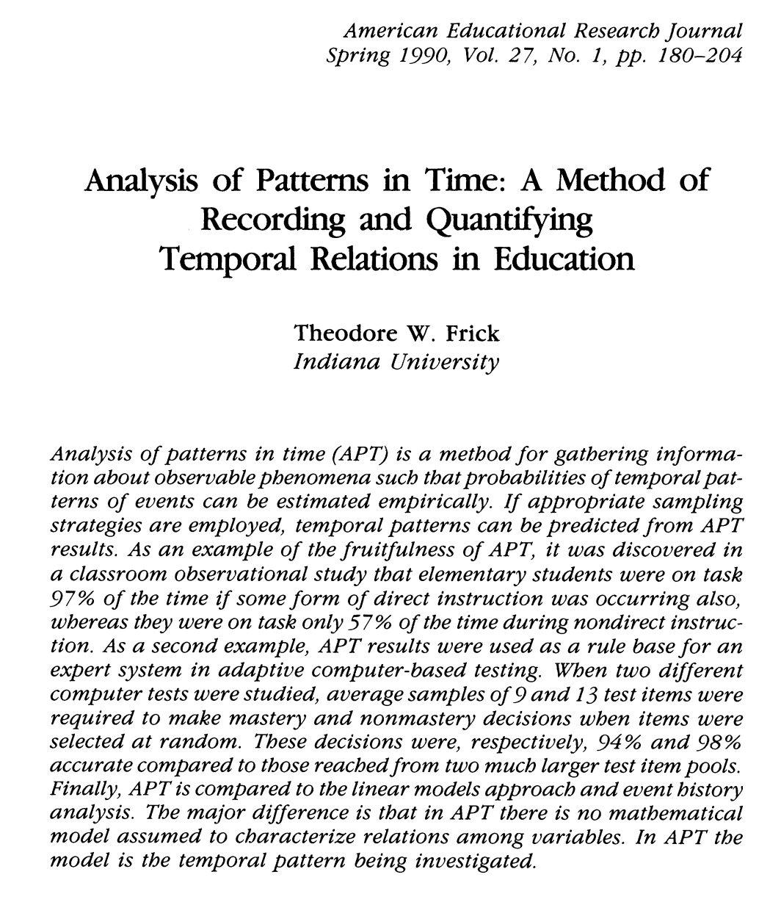
1990:
NTPA name changed to:
Analysis of Patterns in Time
(APT)
Method remained the same--only the name changed

Slide 22
What is Analysis of Patterns in Time (APT)?
APT is a research methodology invented by Frick in 1970s
APT is an alternative to the linear models approach (LMA—e.g., multiple regression, ANOVA): In the 1970s
  LMA was the prevalent quantitative approach to educational research
  Qualitative methods were rarely used in educational research
APT draws from general systems theory, information theory, set theory, probability theory, and Bayesian reasoning
Temporal maps are created as the main source of data for APT
APT queries are then used to segment temporal maps for matching conditions, and for counting occurrences of temporal patterns
APT queries result in probabilistic measures of temporal patterns (likelihoods, odds, cumulative time)

Slide 23
Skipping a lot that happened with APT between
1990 and 2016

Slide 24
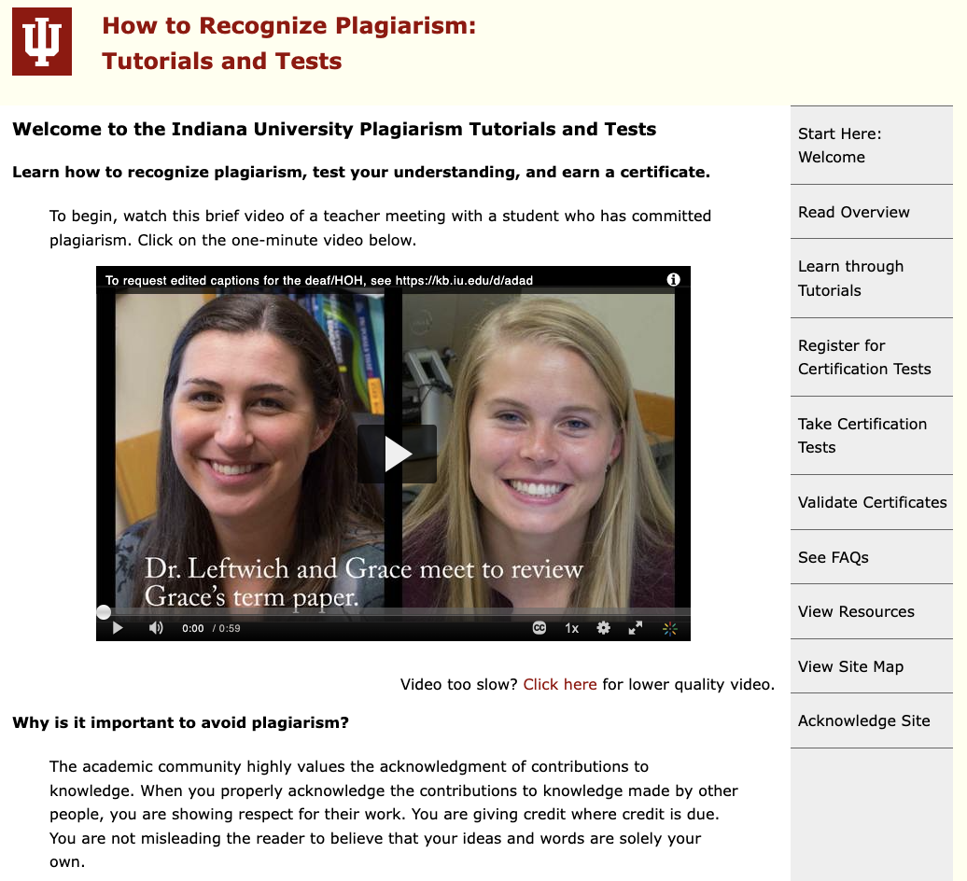
2016:
Redesign of Indiana University Plagiarism Tutorials and Tests (IPTAT) using First Principles of Instruction
[Initial design was in 2002]

Slide 25
First Principles of Instruction (FPI) used to redesign IPTAT: [Source: Merrill, 2020]
Authentic problems or tasks for students to do, arranged from simple to complex (e.g., https://plagiarism.iu.edu/tutorials/index.html);
Activation of student learning by helping students connect new learning with what they already know or believe (e.g., https://plagiarism.iu.edu/tutorials/task1/activation.html);
Demonstration of what is to be learned, by showing a variety of examples (e.g., https://plagiarism.iu.edu/tutorials/task1/demonstration.html);
Application of what is being learned, so students can try themselves and feedback is provided (e.g., https://plagiarism.iu.edu/practiceTest.php?task=1&item=1); and
Integration of what has been learned into students’ own lives (e.g., https://plagiarism.iu.edu/tutorials/task1/integration.html).

Slide 26
From 2016 through 2020,
Google Analytics was creating millions of APT temporal maps on IPTAT usage, but we did not know we could do APT queries with Google Analytics.

Slide 27
Melinda’s Learning Journey
Time | Web Page HTML Title | Web Page URL at https://plagiarism.iu.edu
5:53 p.m. | Certification Tests | /certificationTests/index.html
5:54 p.m. | Welcome | /index.html
5:54 p.m. | Certification Tests | /certificationTests/index.html
6:01 p.m. | Welcome | /index.html
6:05 p.m. | Organization of Instruction | /organization.html
6:06 p.m. | How to Navigate | /navigation.html
6:06 p.m. | Overview | /overview/index.html
6:07 p.m. | What you should do | /overview/shouldDo.html
6:08 p.m. | But I won't get caught | /overview/easyDetection.html
6:10 p.m. | R U a dupe? | /overview/RUAdupe.html
6:14 p.m. | The Slippery Slope with Symbolic Signs | /overview/signs.html
6:29 p.m. | Cases of Plagiarism | /overview/cases.html
6:33 p.m. | Tutorials and Practice Tests | /tutorials/index.html
6:33 p.m. | Task 1 Overview | /tutorials/task1/index.html
6:37 p.m. | A Video Case | /tutorials/task1/activation.html
6:44 p.m. | Demonstration | /tutorials/task1/demonstration.html
6:47 p.m. | Demonstration Continued | /tutorials/task1/demonstration2.html
6:50 p.m. | Practice with One Item at a Time | /practiceTest.php?task=1&item=1
6:51 p.m. | Practice Question Result and Feedback | /practiceTestResults.php
6:51 p.m. | Practice with One Item at a Time | /practiceTest.php?task=1&item=2
6:52 p.m. | Practice Question Result and Feedback | /practiceTestResults.php
6:52 p.m. | Practice with One Item at a Time | /practiceTest.php?task=1&item=3
6:52 p.m. | Practice Question Result and Feedback | /practiceTestResults.php
6:53 p.m. | Practice with One Item at a Time | /practiceTest.php?task=1&item=4
6:53 p.m. | Practice Question Result and Feedback | /practiceTestResults.php
6:53 p.m. | Task 1 Integration | /tutorials/task1/integration.html
Temporal Map
Part of Google Analytics ‘session’ on Sunday, October 4, 2020.
Melinda had 2 GA sessions, totaling 148 minutes in duration, separated by a 52-min. break between sessions.
Etc.

Slide 28
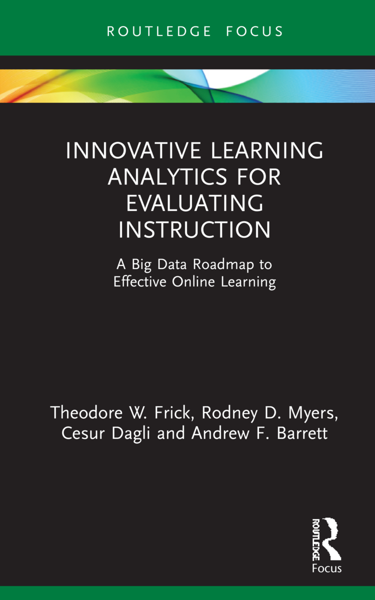
New book: 2022
Google Analytics tracked student use of IPTAT website for 2 years, 2019-20
  Approximately 936,000 learning journeys, students from 222 countries and territories worldwide
  About 1.9M temporal maps, 36M pageviews
We discovered in 2020 that Google’s Universal Analytics (UA) could be leveraged to do Analysis of Patterns in Time (APT) when coupled with Excel spreadsheets
Main APT finding: Successful students viewed 3 to 4 times as many unique Web pages designed with First Principles of Instruction as did unsuccessful students

Slide 29
Latest APT Results from 131,083 Learning Journeys Using Google Analytics 4 (Aug. 21 – Oct. 18, 2022)
Learning Strategy | Non-Achiever | Achiever | Total | Likelihood of Passing | Likelihood of Failing | Odds P:F
Guessing (theoretical) | 19,682 | 1 | 19,683 | 0.000 | 1.000 | 0.00
Minimalist (No FPI) | 7,918 | 6,836 | 14,754 | 0.463 | 0.537 | 0.86
Traditionalist: Any FPI | 16,532 | 34,551 | 51,083 | 0.676 | 0.324 | 2.09
Plagiarism Patterns Only | 7,898 | 14,765 | 22,663 | 0.652 | 0.348 | 1.87
Practice Questions with Feedback | 5,989 | 15,350 | 21,339 | 0.719 | 0.281 | 2.56
Maximalist (some of each FPI) | 1,607 | 6,424 | 8,031 | 0.800 | 0.200 | 4.00
Achievers & Test Evals | 40,838
Non-Achievers & Test Evals | 23,834
Total Test Evals | 64,672
Active Users & No Test Evals | 66,411
Grand Total Learning Journeys | 131,083
Maximalists were 4 times more likely to pass a Certification Test. Maximalists had tried at least some of each part of IPTAT designed with First Principles of Instruction.

Slide 30
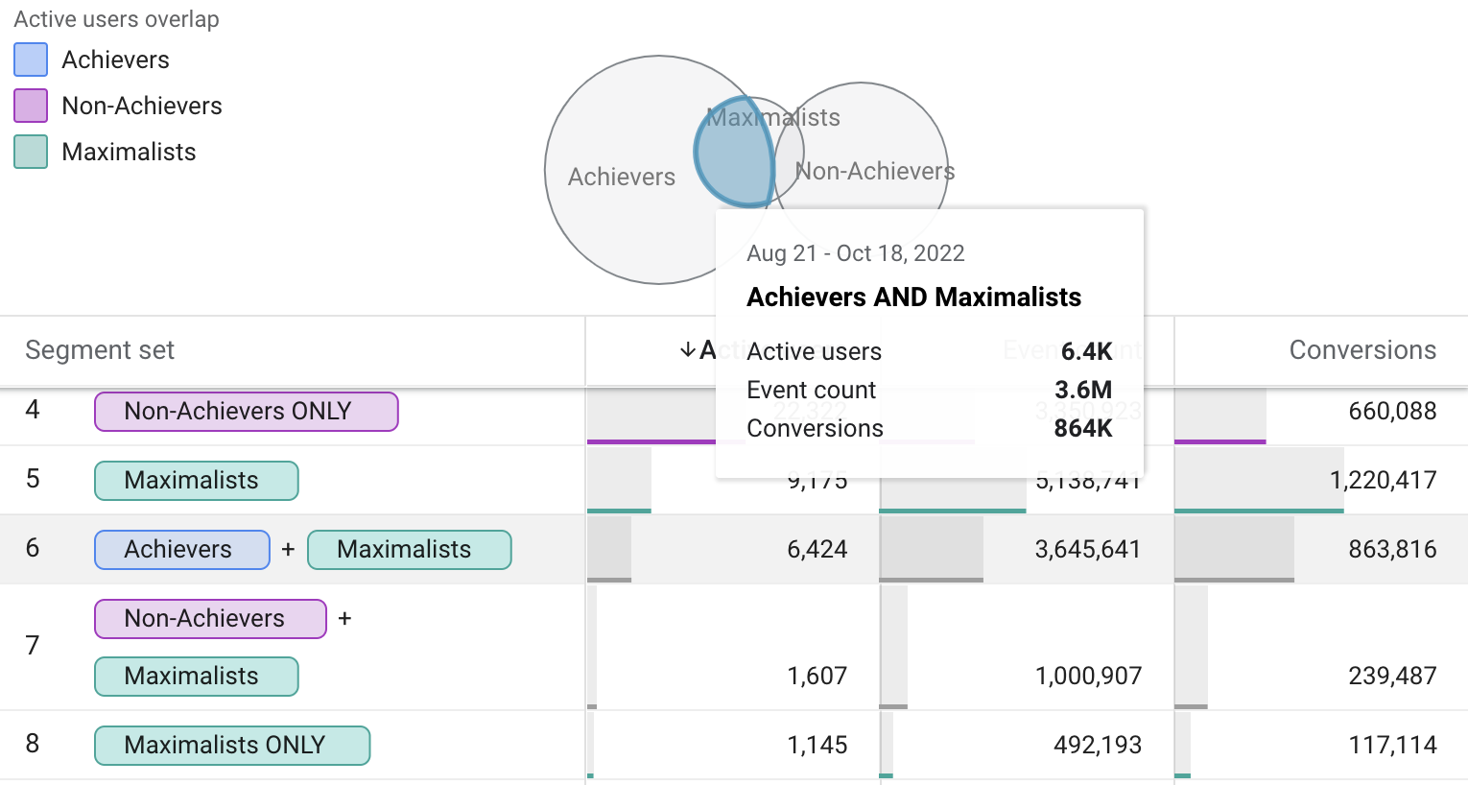
Doing Analysis of Patterns in Time with
Google Analytics 4 (GA4) Segment Overlap

Slide 31
Summary
After 50 years of research with Analysis of Patterns in Time

Slide 32
Summary: Analysis of Patterns in Time
APT is a fruitful methodology for investigating the instrumental value of instruction to promote student learning achievement.
GA4 when supplemented with Excel can do some kinds of APT as envisioned originally by Frick (1983, 1990) and Myers and Frick (2015).
GA4 is somewhat easier to use for doing APT when compared with Google’s earlier Universal Analytics. In both cases, Excel is needed for further computations of likelihoods and Bayesian analysis.
For more on APT and designing online instruction with First Principles of Instruction, see our new book: Innovative Learning Analytics for Evaluating Instruction: A Big Data Roadmap for Effective Online Learning (2022, Routledge Focus Series)

Slide 33
References
Frick, T. W. (1983). Nonmetric temporal path analysis: An alternative to the linear models approach for verification of stochastic educational relations [Unpublished doctoral dissertation]. Indiana University Graduate School. https://tedfrick.sitehost.iu.edu/ntpa/
Frick, T. W. (1990). Analysis of patterns in time (APT): A method of recording and quantifying temporal relations in education. American Educational Research Journal, 27(1), 180-204. https://tedfrick.sitehost.iu.edu/apt/aerj.pdf
Frick, T. W. & Dagli, C. (2016). MOOCs for research: The case of the Indiana University plagiarism tutorials and tests. Technology, Knowledge and Learning, 21(2), 255-276. https://rdcu.be/mEvf
Frick, T. W., Myers, R. D., & Dagli, C. (2022). Analysis of Patterns in Time for Evaluating First Principles of Instruction (SharedIt): https://doi.org/10.1007/s11423-021-10077-6
Frick, T. W., Myers, R. D., Dagli, C., & Barrett, A. F. (2022). Innovative learning analytics for evaluating instruction: A big data roadmap to effective online learning. Routledge. https://doi.org/10.4324/9781003176343
Google Analytics (2005 - present). Wikipedia entry: https://en.wikipedia.org/wiki/Google_Analytics
Indiana University Plagiarism Tutorials and Tests (2002-present). How to recognize plagiarism. Retrieved from https://plagiarism.iu.edu
Merrill, M. D. (2020). M. David Merrill’s first principles of instruction. Association for Educational Communications and Technology.
Myers, R. & Frick, T. W. (2015). Using pattern matching to assess gameplay. In C. S. Loh, Y. Sheng, & D. Ifenthaler (Eds.), Serious games analytics: Methodologies for performance measurement, assessment, and improvement, (Chapter 19, pp. 435-458). Springer. https://tedfrick.sitehost.iu.edu/apt/patternMatchingToAssessGameplay.pdf

Slide 34
Viewers of this presentation would also benefit from complementary presentations at AECT:
Frick, T. (2022, Oct.). MOOC Turns 20 Years Old: How to Recognize Plagiarism. At the annual conference of the Association of Educational Communications and Technology, Las Vegas, NV.
Thu, Oct 27, 2:10 to 2:25pm PDT (5:10 to 5:25pm EDT), Virtual, Online B

Slide 35
Acknowledgements
Recent contributors to research with Analysis of Patterns in Time
  Rodney Myers, Ph.D., Indiana University
  Cesur Dagli, Ph.D., Virginia Tech University

Slide 36
Links for Using Google Analytics to do Analysis of Patterns in Time (APT)
Video demonstrations
  https://plagiarism.iu.edu/apt/demo/index.html
For background on APT, see also
  https://plagiarism.iu.edu/apt/index.html
Slides of this presentation (PDF)
  https://plagiarism.iu.edu/apt/APT_FruitfulMethod.pdf
Link to recording of this presentation
  https://mapsat.iu.edu

